Slide 1
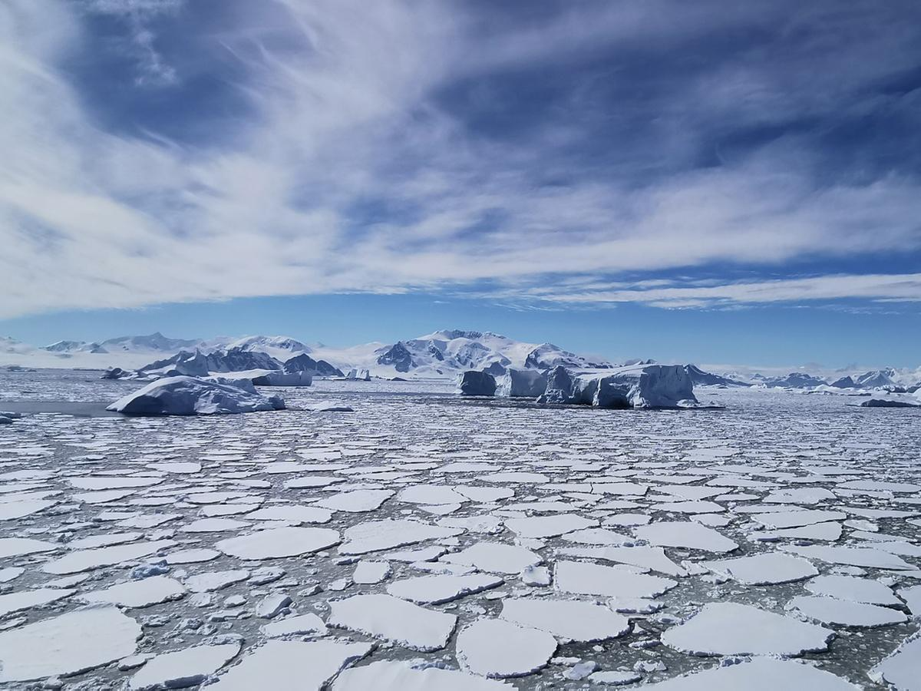
A Comparison of the Seasonal Ocean Heat Gain from Three Reanalyses
Meghan Helmberger & Mark Serreze

Slide 2
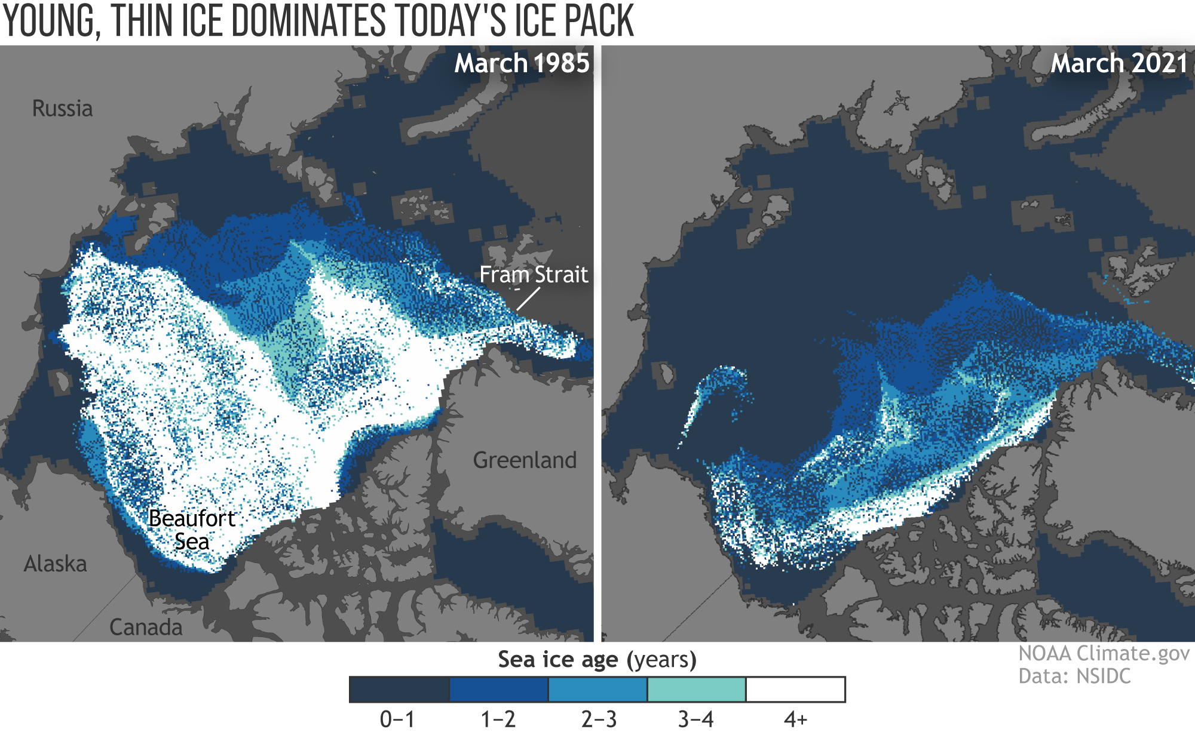
Sea ice is getting younger and thinner
Notes:
I won’t go over this in too much detail because I know all of us here are very familiar with the changes that are occurring in the Arctic in regards to sea ice, but I liked this figure because it showed the thickness and extent changes that have occurred over the last 40 years. The left shows the sea ice age and extent in March 1985 and the right shows March 2021 (which shows the largest extent for the year). Typically, the oldest ice is the thickest with the exception of ridges between younger ice flows. These facts influenced my interest in

Slide 3
Objectives
What are the spatial and temporal patterns in ocean heat gain over time (1979-2018)?
How different is the ocean heat gain between different reanalyses?
Does separating ocean heat gain over sea ice and open water change the trends?
Is there a trend in ocean heat gain that fits with the observed decrease in sea ice extent?

Slide 4
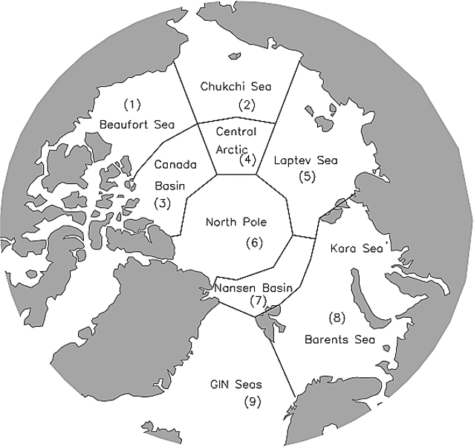
Methods
Averaged from sub-daily to daily
Calculated ocean heat gain using the surface heat flux equation
Values separated over ice and open water using the coordinating sea ice data from the reanalysis
Summed to monthly values
Subset from April through August (full months after the sea ice extent maximum and before the sea ice extent minimum)
Summed to seasonal values
Subset for regions 1-6 & 8

Slide 5
How is ocean heat gain (OHG) calculated?
Surface Heat Flux = (SW_{d} + SW_{u})+(LW_{d} + LW_{u}) + Q_{H} + Q_{E}
OHG = ∑ (Surface Heat Flux * Δt)
_{From April to August each year}
SW_{d}: shortwave down to the surface
SW_{u}: shortwave reflected out to space
LW_{d}: longwave down to the surface
LW_{u}: longwave emitted back to space
Q_{H}: sensible heat
Q_{E}: latent heat
Notes:
I calculated ocean heat gain by summing the surface energy flux shown in the top equation, over time. All data was downloaded at sub-daily values and summed from April through August, which are the first month after the sea ice extent maximum and the last month before the sea ice extent minimum, respectively. All values are positive downward into the ocean column and are negative upwards to the atmosphere. So energy is positive downwards is energy stored in the ocean column. The net radiation calculation is listed in the bottom equation. The results that I will show uses these calcuations.

Slide 6
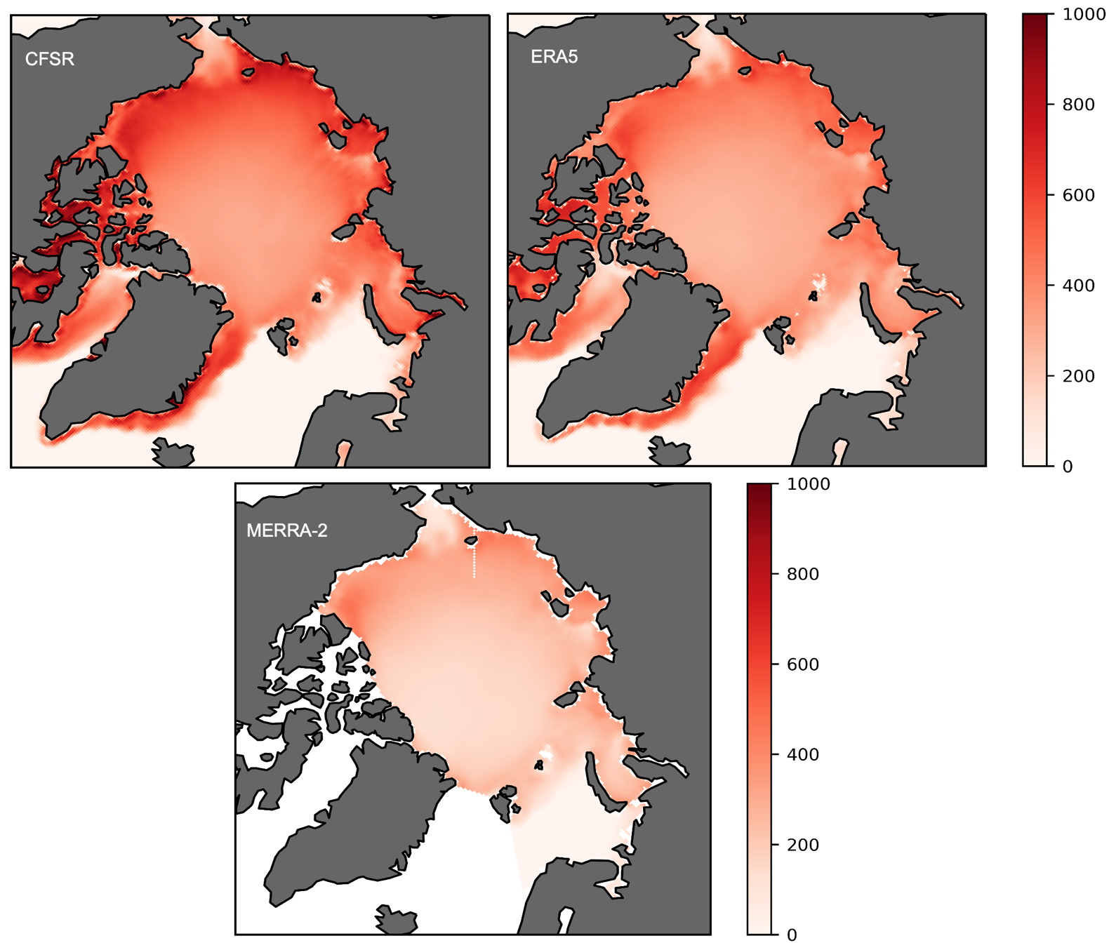
Climatological average of OHG (MJ/m²) over sea ice shows large differences across the Arctic

Slide 7
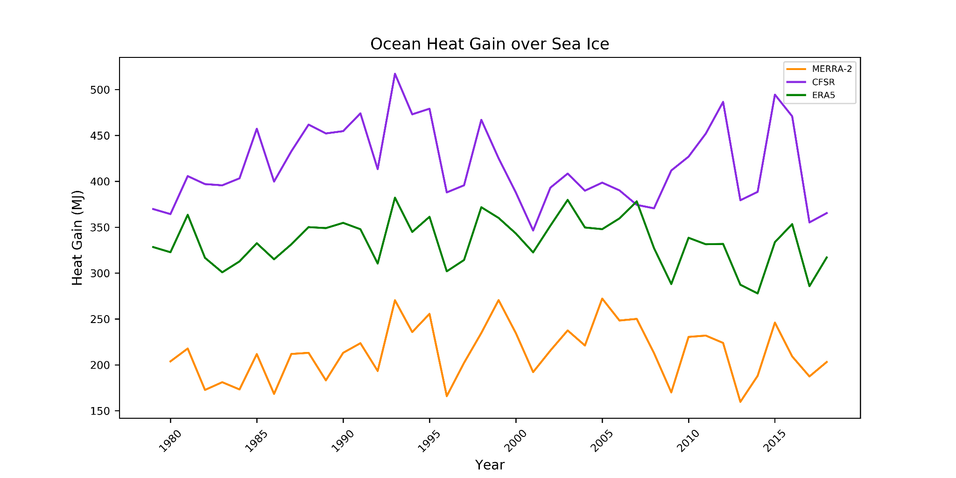
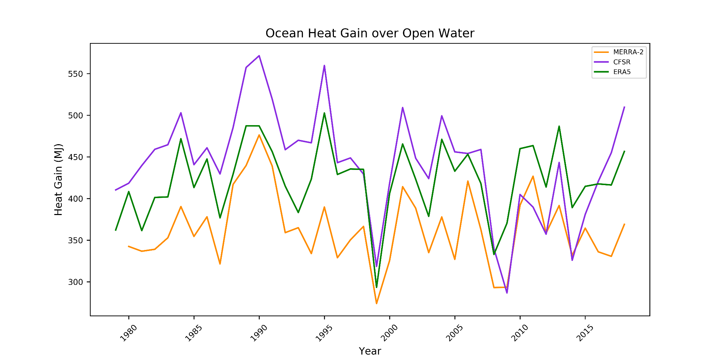
OHG over sea ice and open water show different patterns and no positive trend lines.
Sea Ice Points
Ocean heat gain (MJ/m²)
Ocean Points
Notes:
top: Yearly ocean heat gain from the net surface heat flux from April to August 1979 to 2018 over sea ice across the Arctic Ocean from ERA5 (green), CFSR (purple), and MERRA-2 (orange).
bottom: Yearly ocean heat gain from the net surface heat flux from April to August 1979 to 2018 over open water across the Arctic Ocean from ERA5 (green), CFSR (purple), and MERRA-2 (orange).

Slide 8
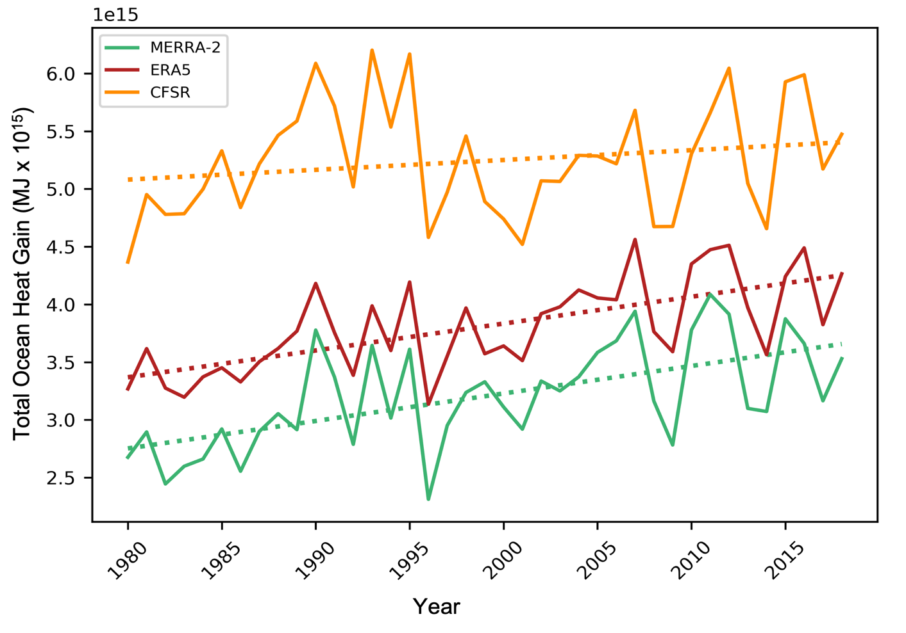
When OHG values are taken over the whole ocean there is a positive trend but large spread
Total Ocean Heat Gain (MJ x 10¹⁵)
Year
Notes:
Average seasonal ocean heat gain from the net surface flux from April to August 1979 to 2018 across the central Arctic Ocean and the marginal seas from ERA5 (blue), CFSR (green), and MERRA-2 (orange).

Slide 9
Ice/open water subsetting
Whole ocean calculations
Arctic Ocean
Arctic Ocean
Ice cover
Open ocean
Idealized, not to scale

Slide 10
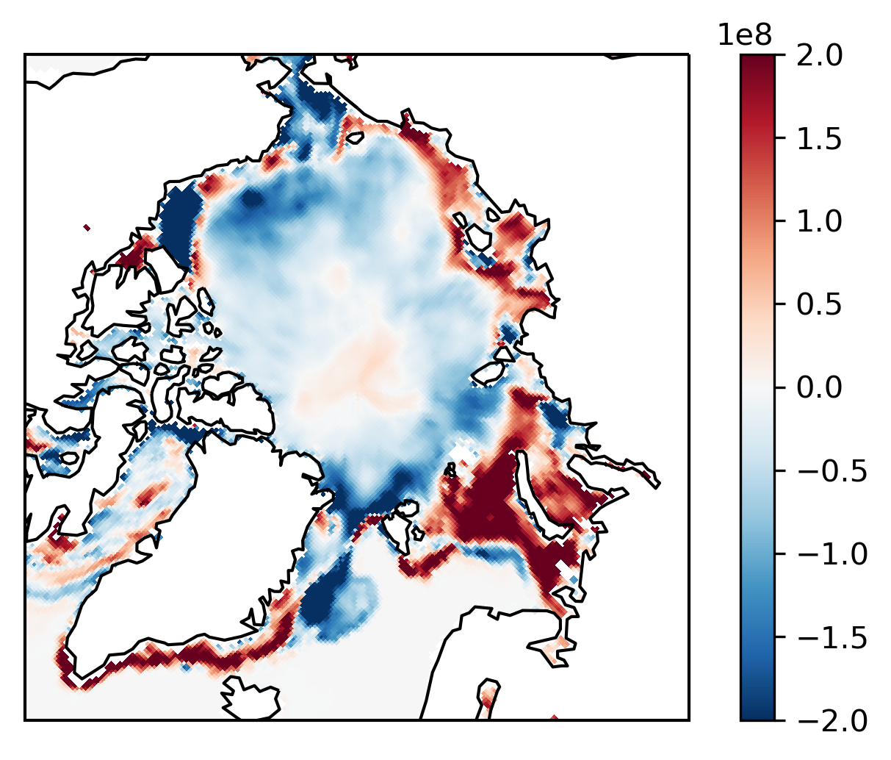
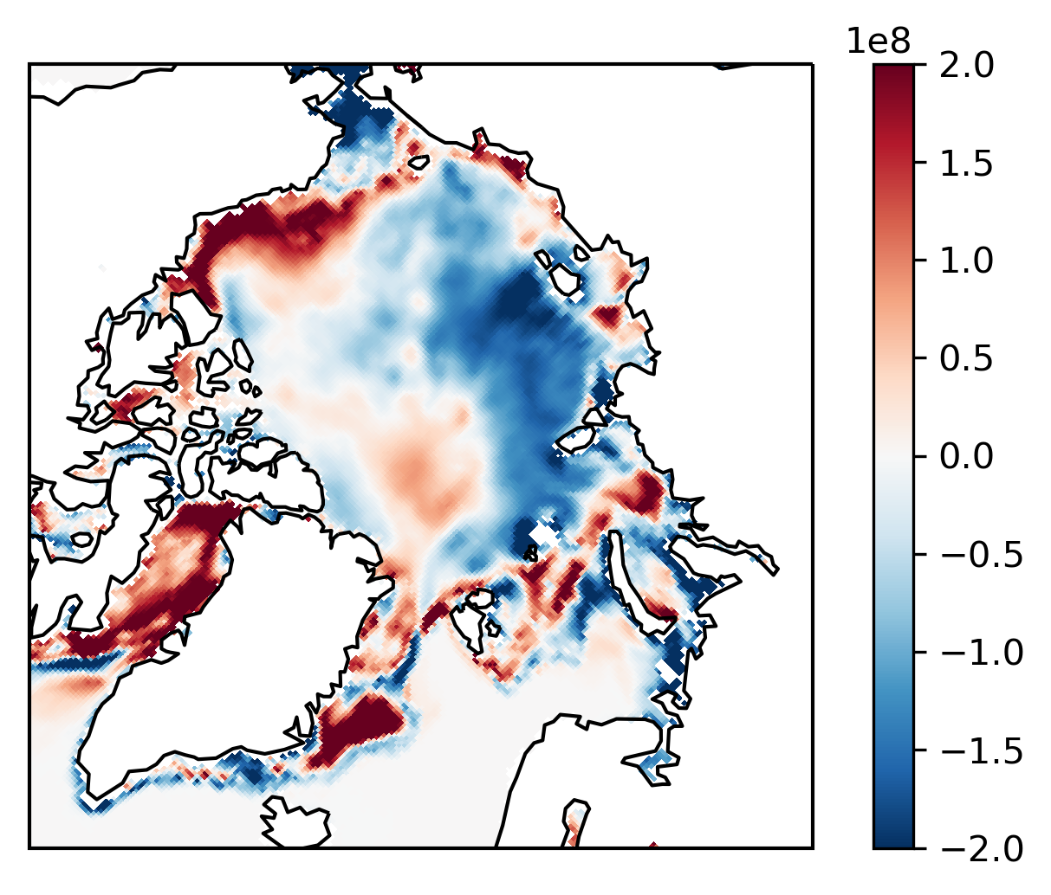
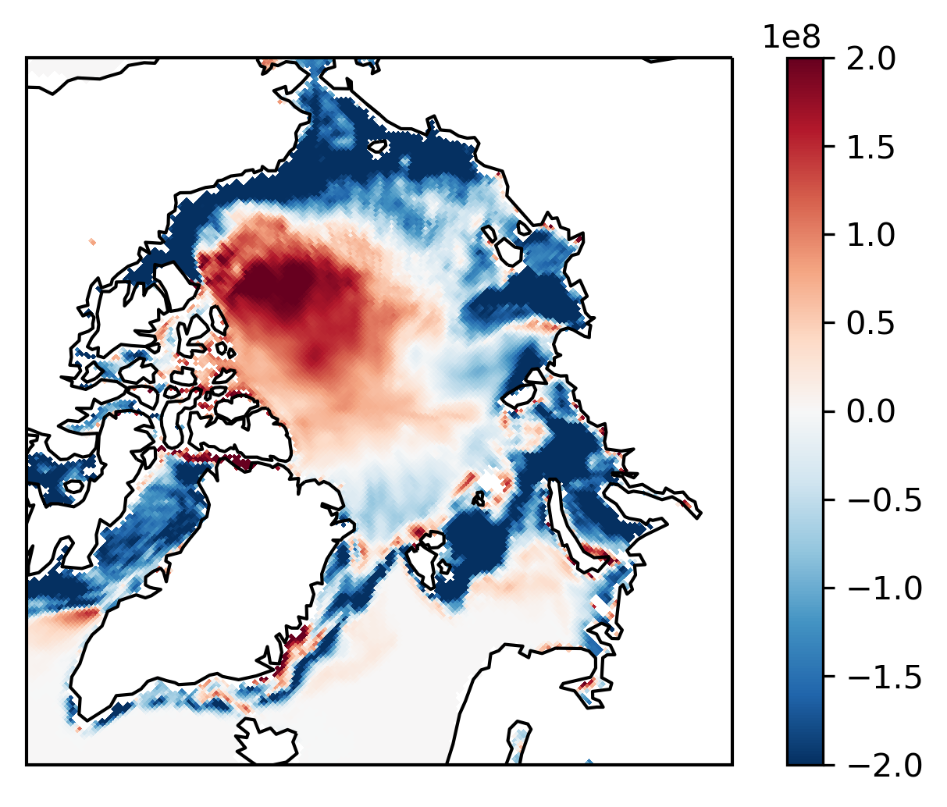
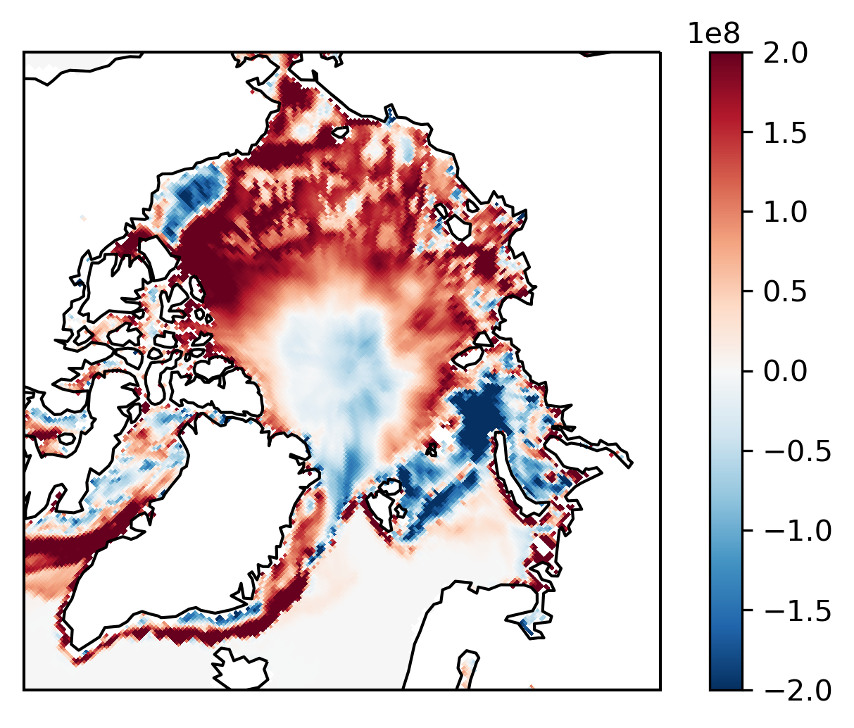
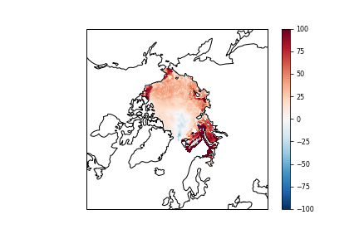
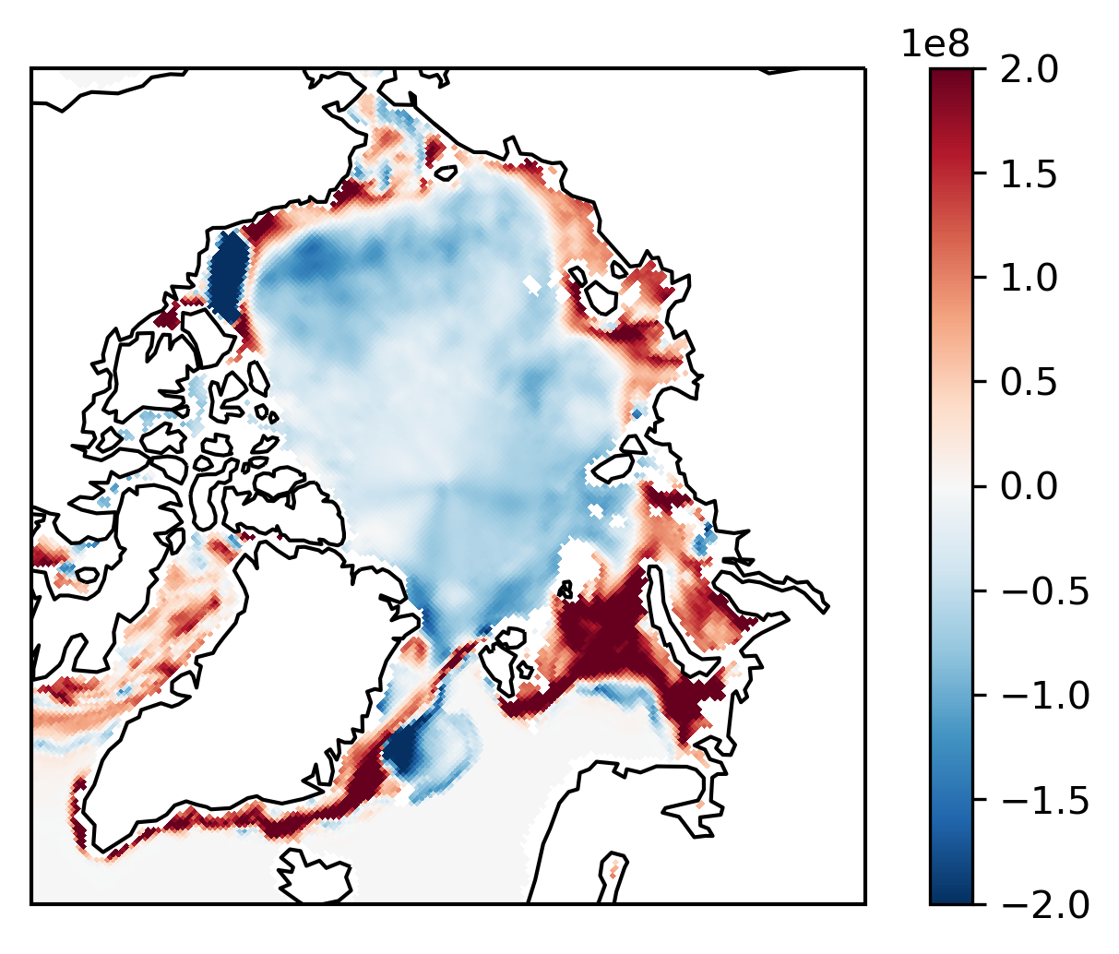
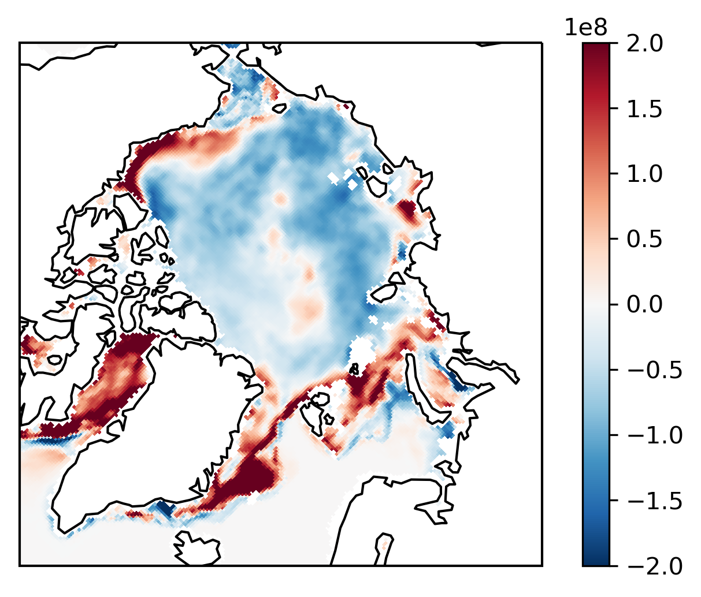
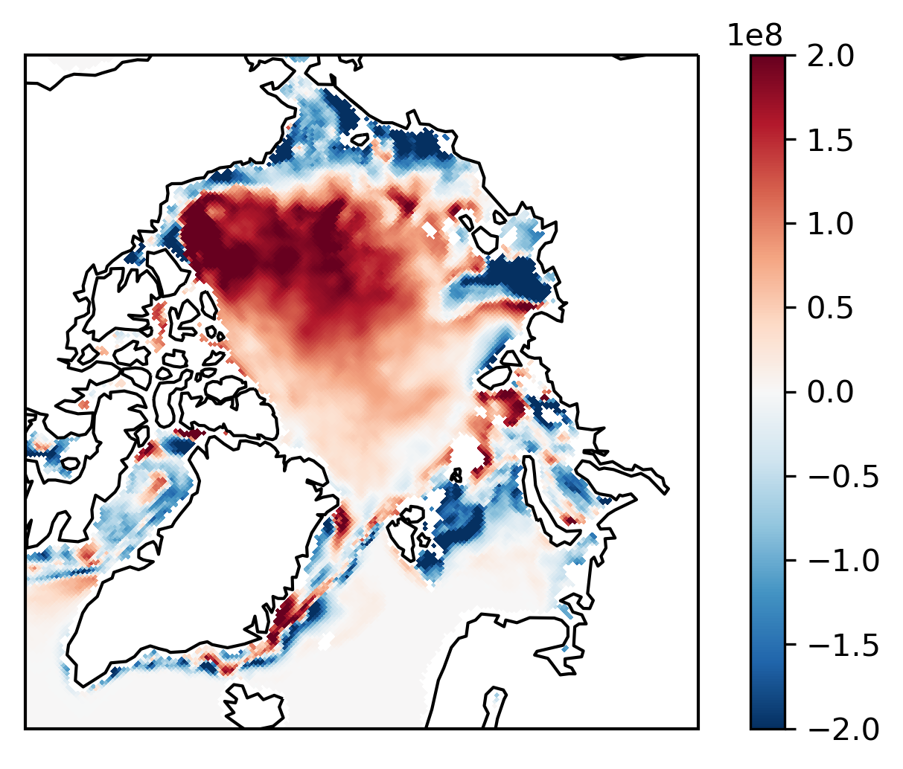
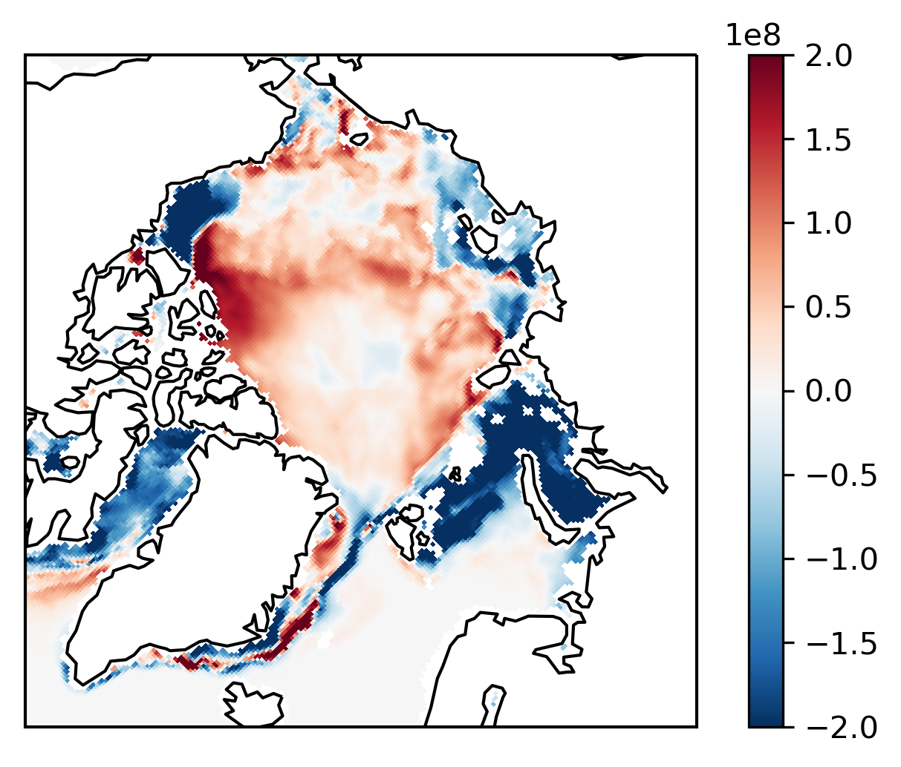
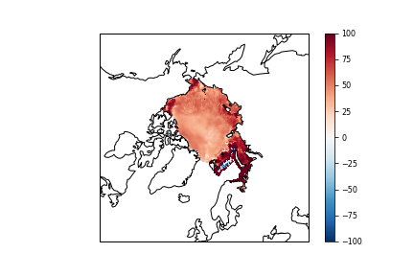
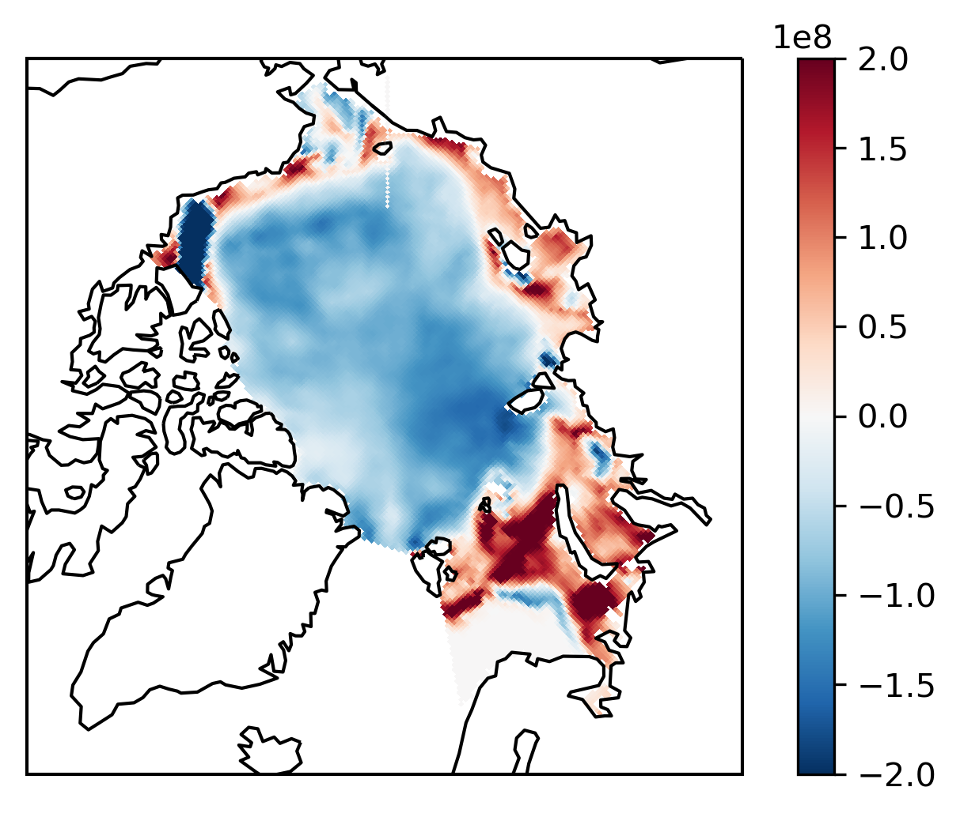
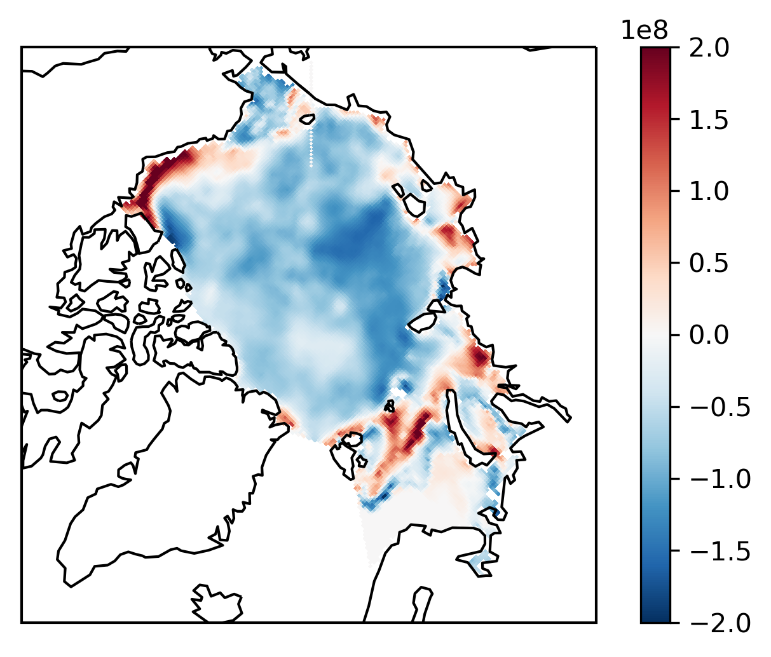
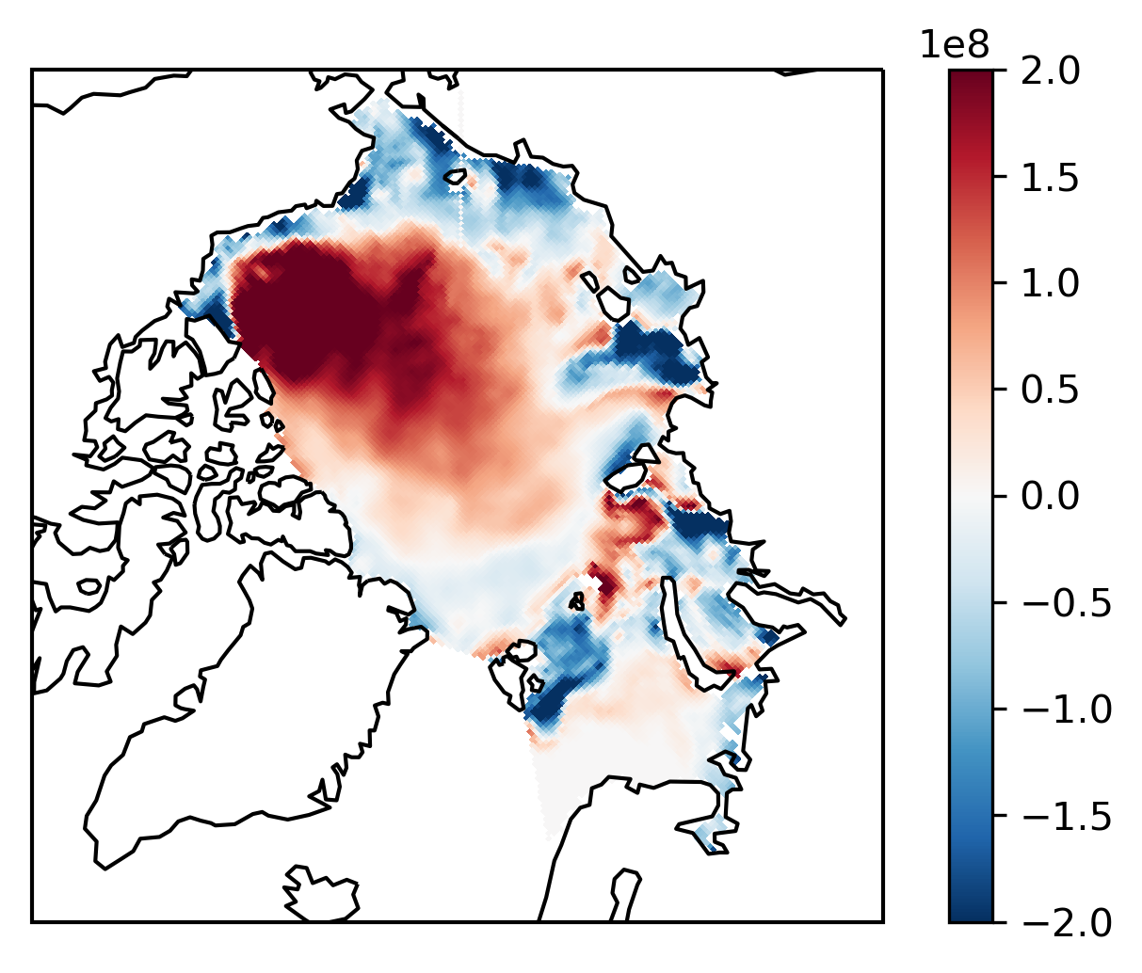
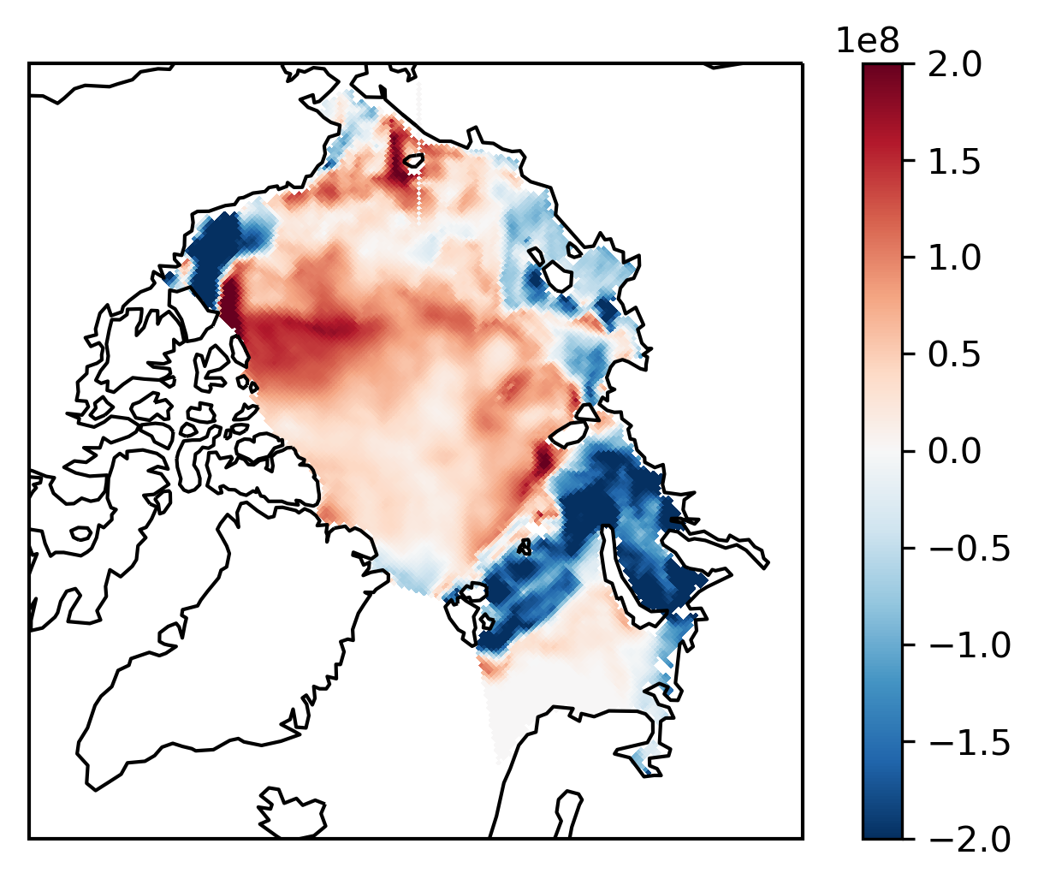
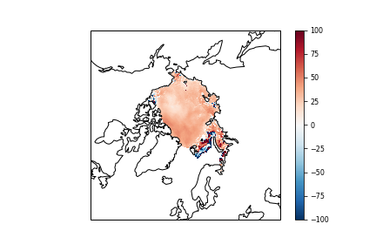
Spatial OHG differences in significant years show similar patterns between reanalyses over sea ice
1982
1996
2007
2012
1982
1996
2007
2012
CFSR
CFSR vs. ERA5
ERA5
CFSR vs. MERRA-2
MERRA-2
ERA5 vs. MERRA-2
Notes:
Left: Spatial distribution of seasonal ocean heat gain anomalies over sea ice from April to august in 1982,1996,2007, and 2012 from CFSR, ERA5, MERRA-2
Right: percent differences for the same times and models

Slide 11
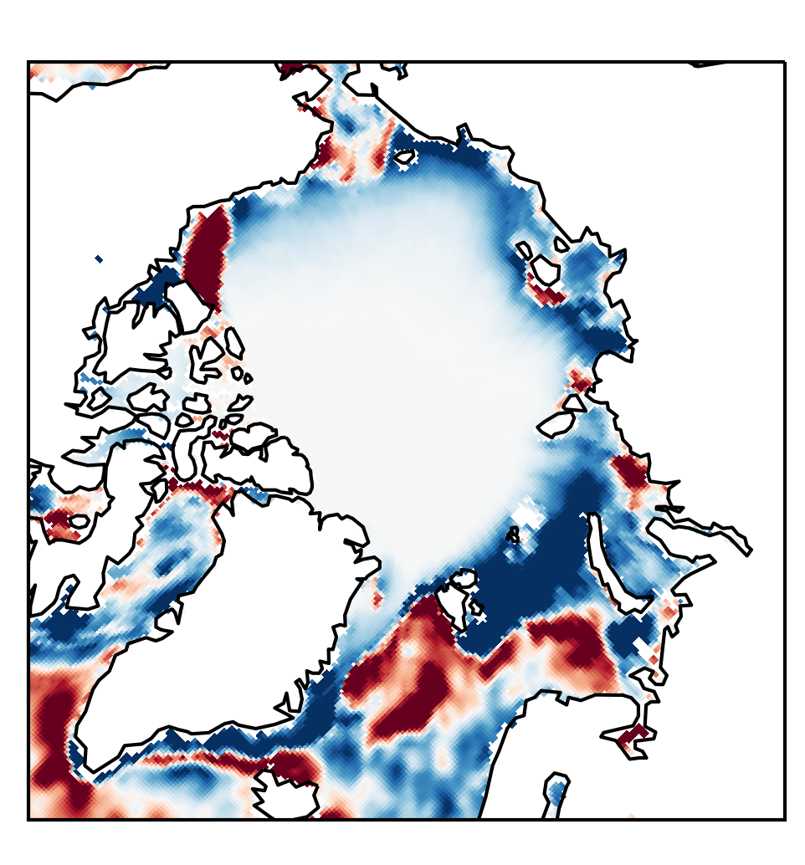
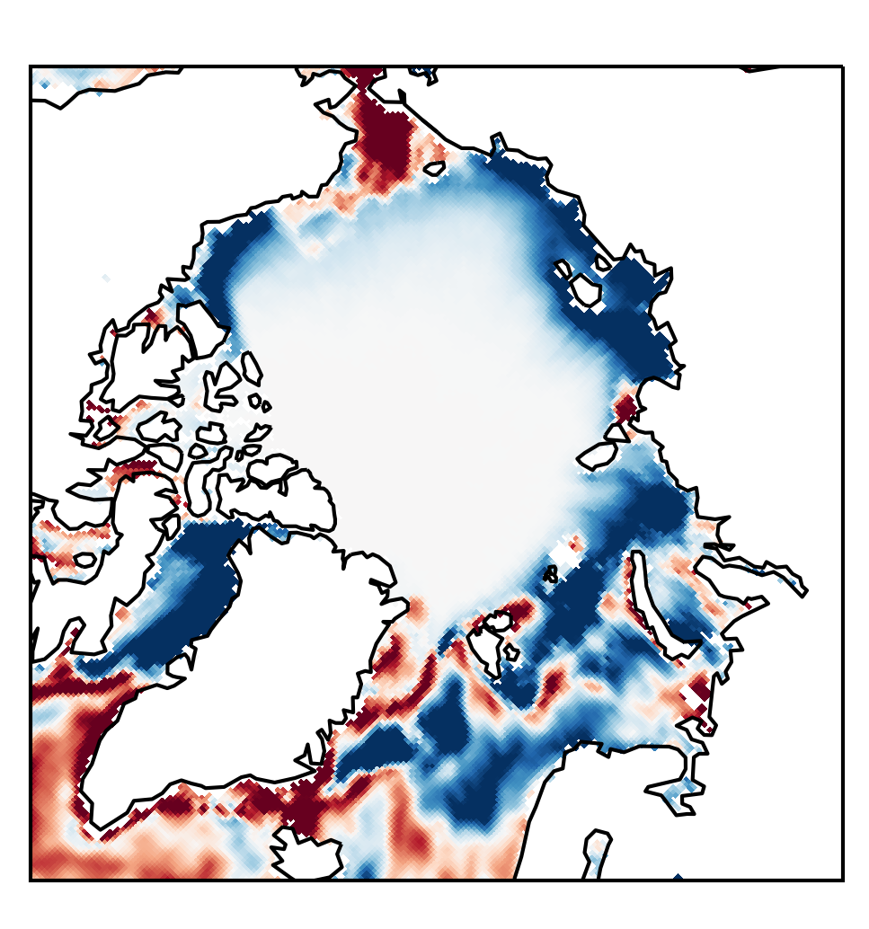
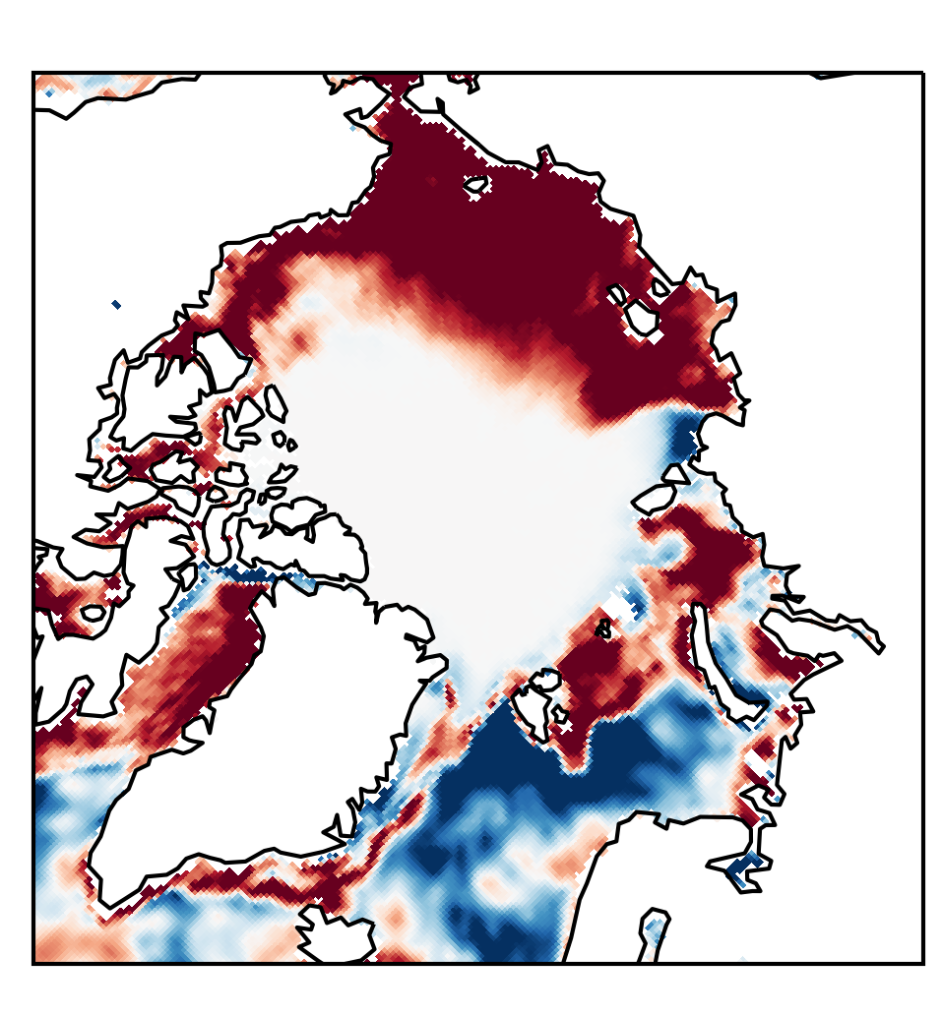
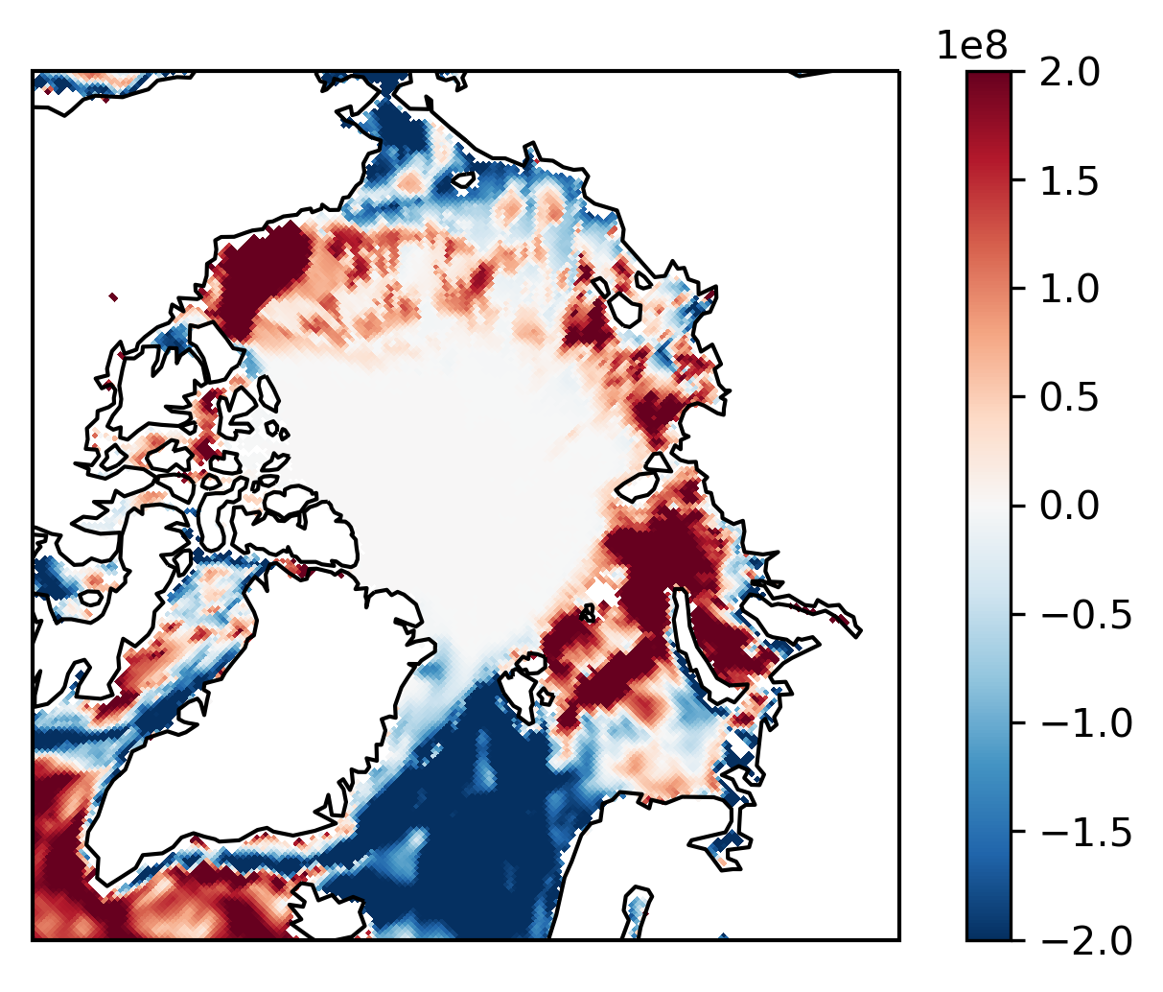
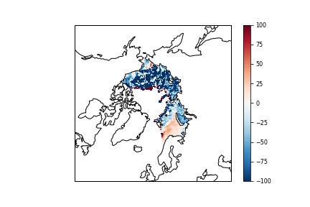
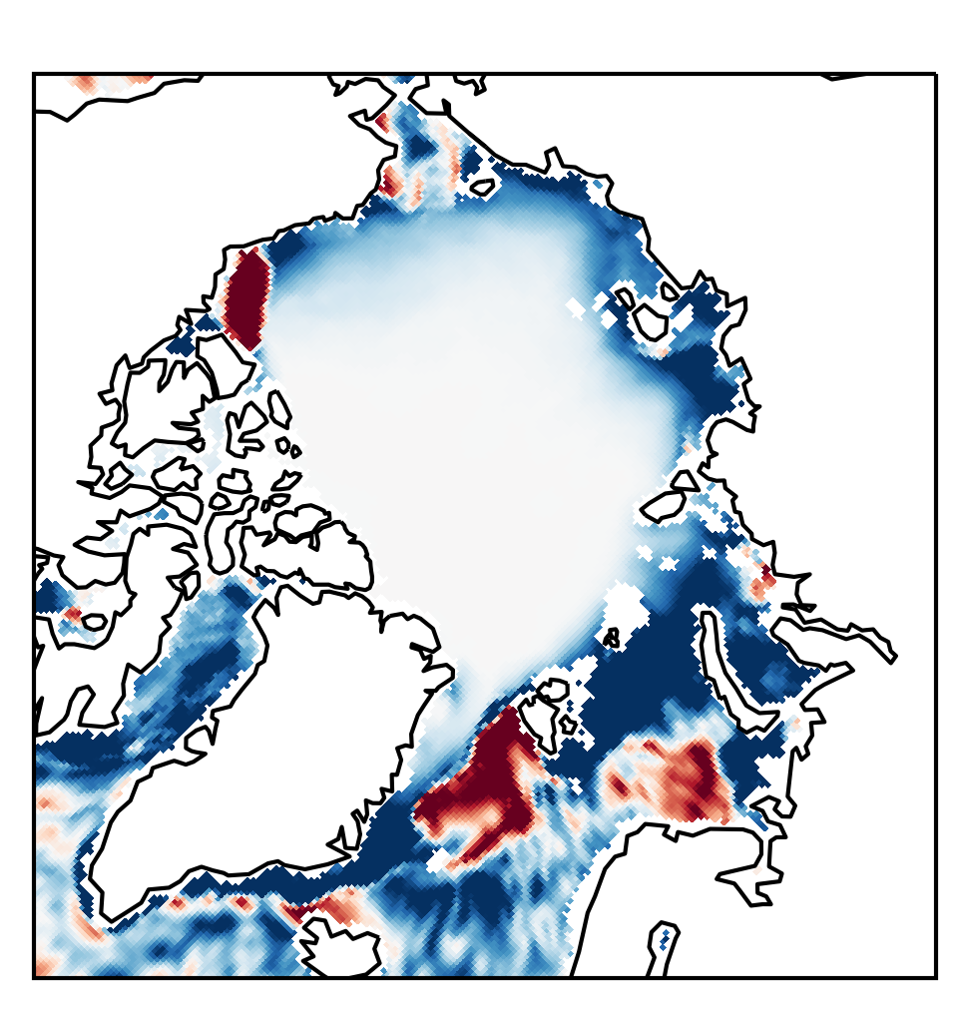
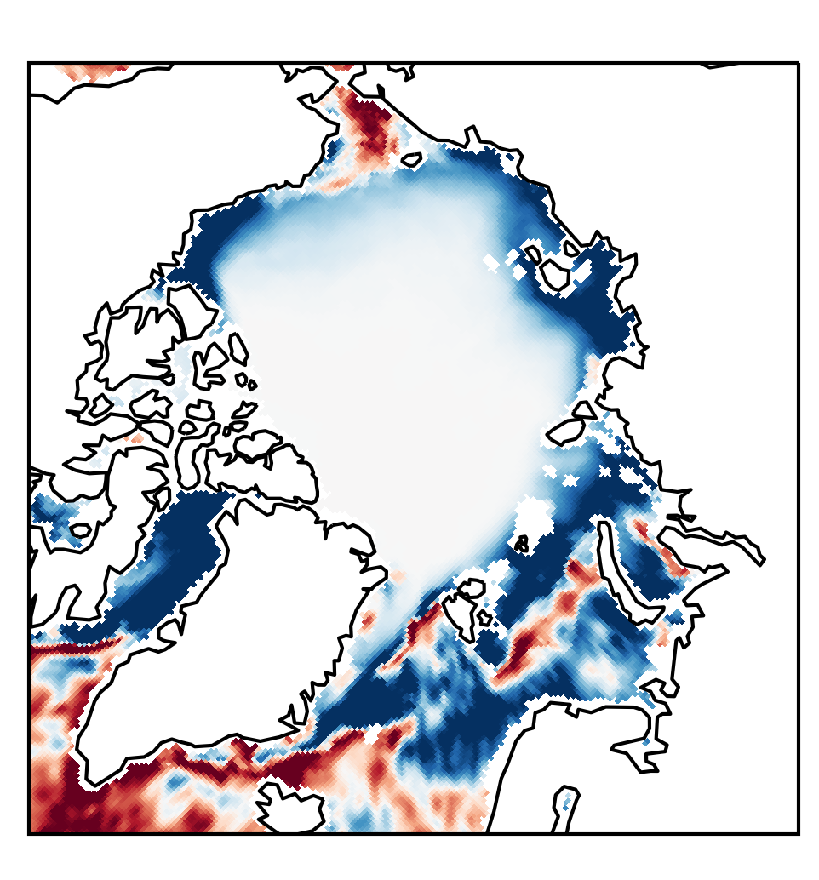
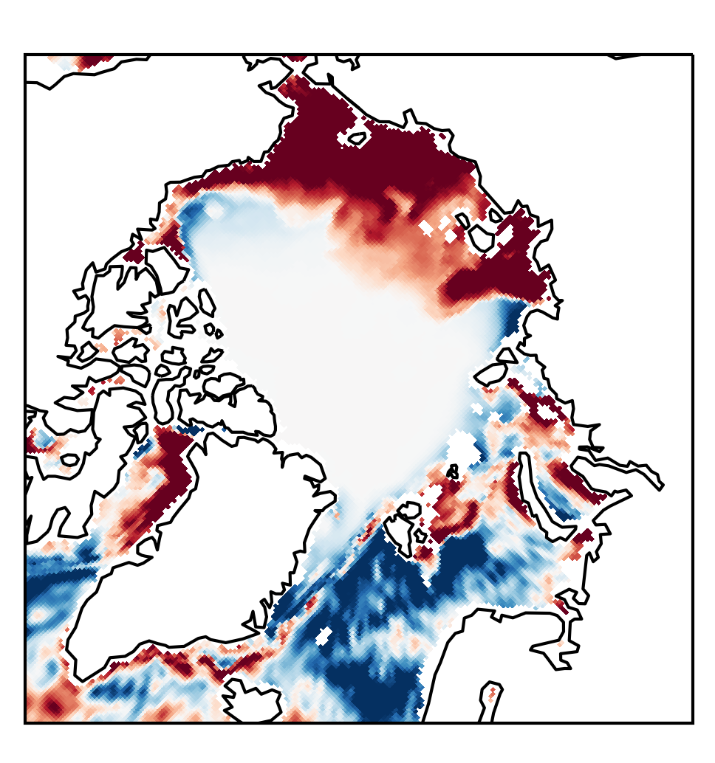
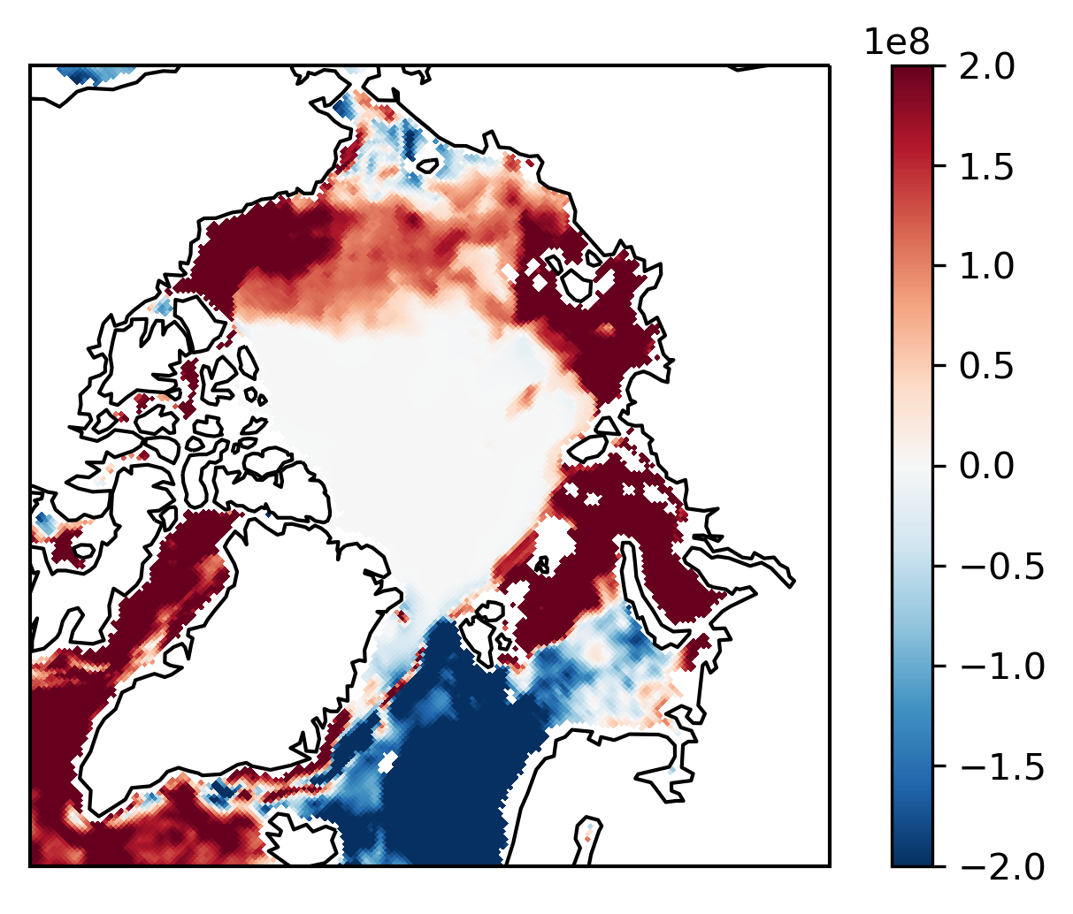
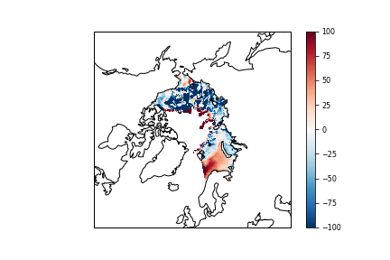
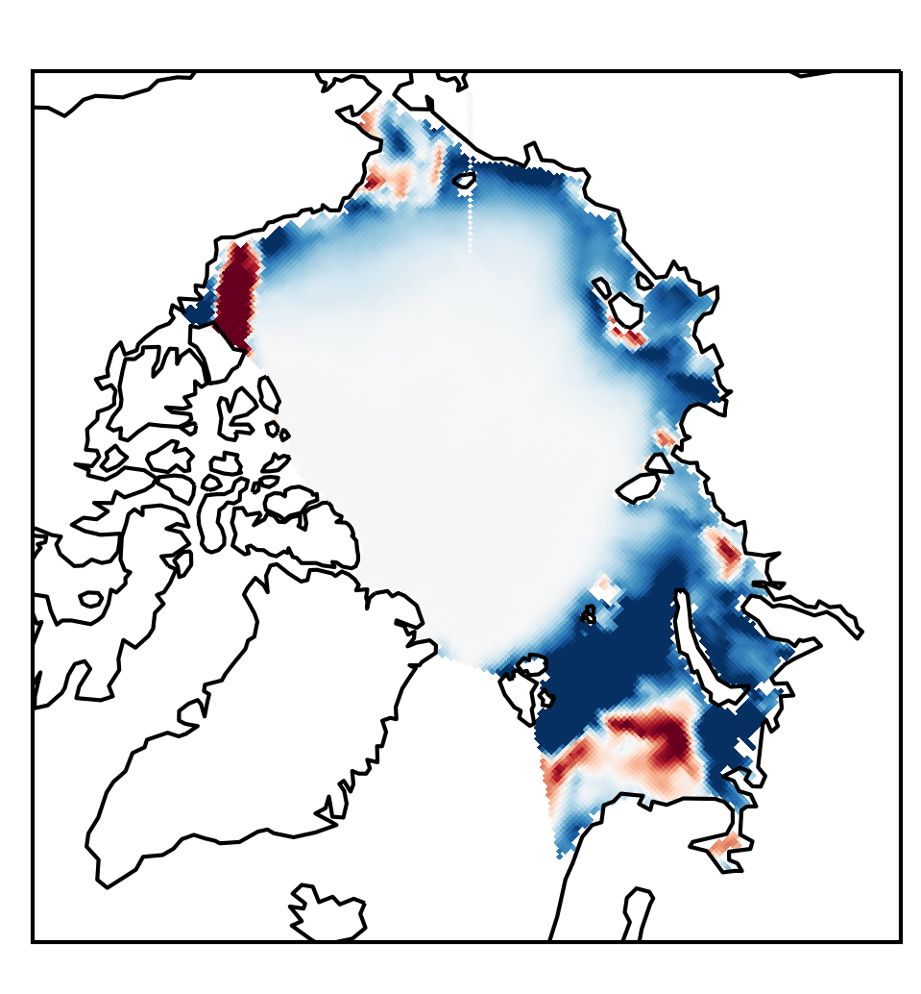
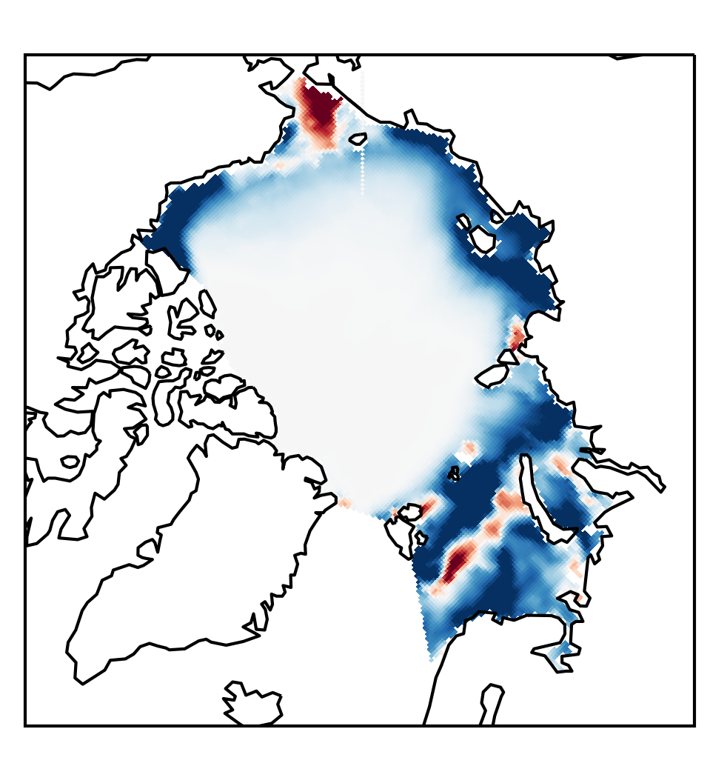
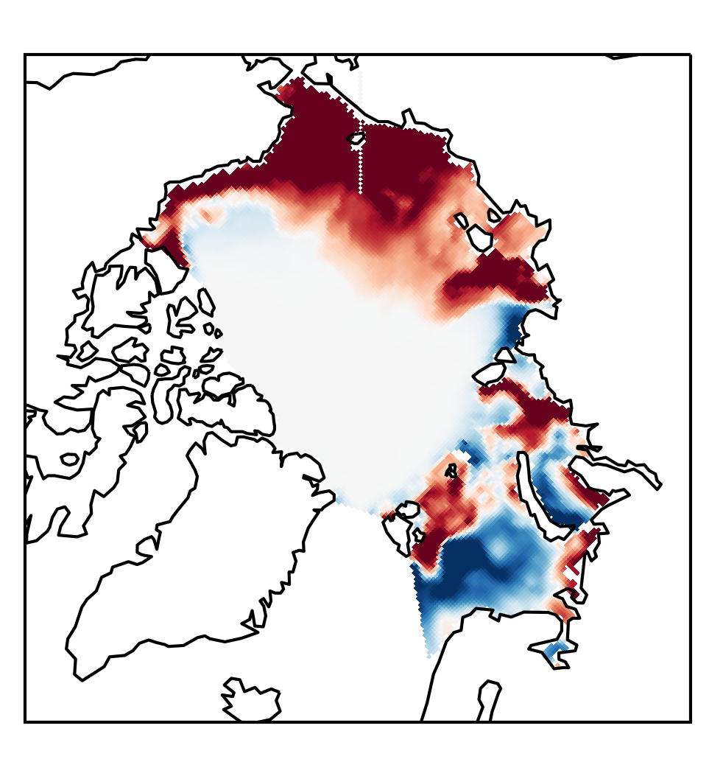
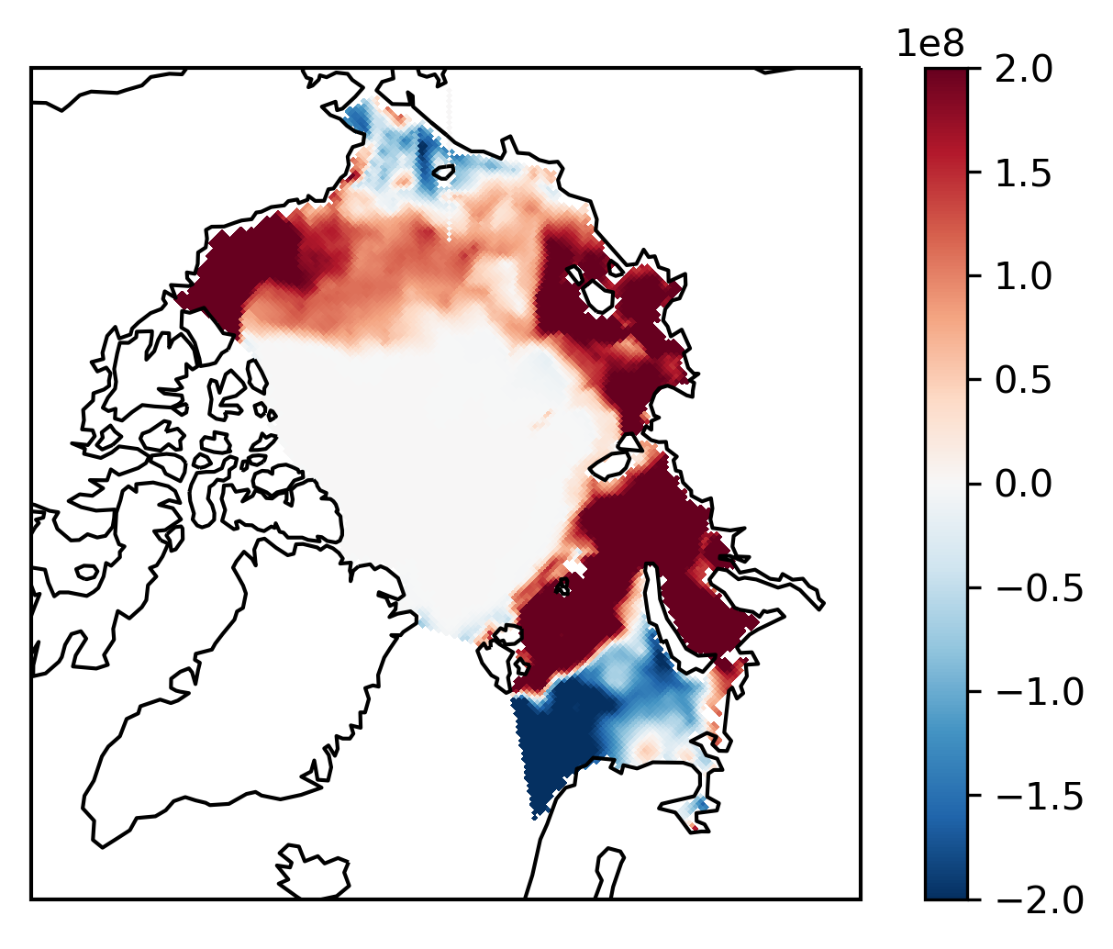
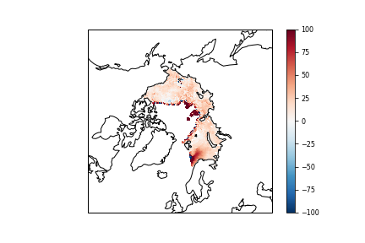
Spatial OHG differences in significant years show similar patterns between reanalyses over open water
1982
1996
2007
2012
1982
1996
2007
2012
CFSR
CFSR vs. ERA5
CFSR vs. MERRA-2
ERA5
MERRA-2
ERA5 vs. MERRA-2
Notes:
Left: Spatial distribution of seasonal ocean heat gain anomalies over open water from April to august in 1982,1996,2007, and 2012 from CFSR, ERA5, MERRA-2
Right: percent differences

Slide 12
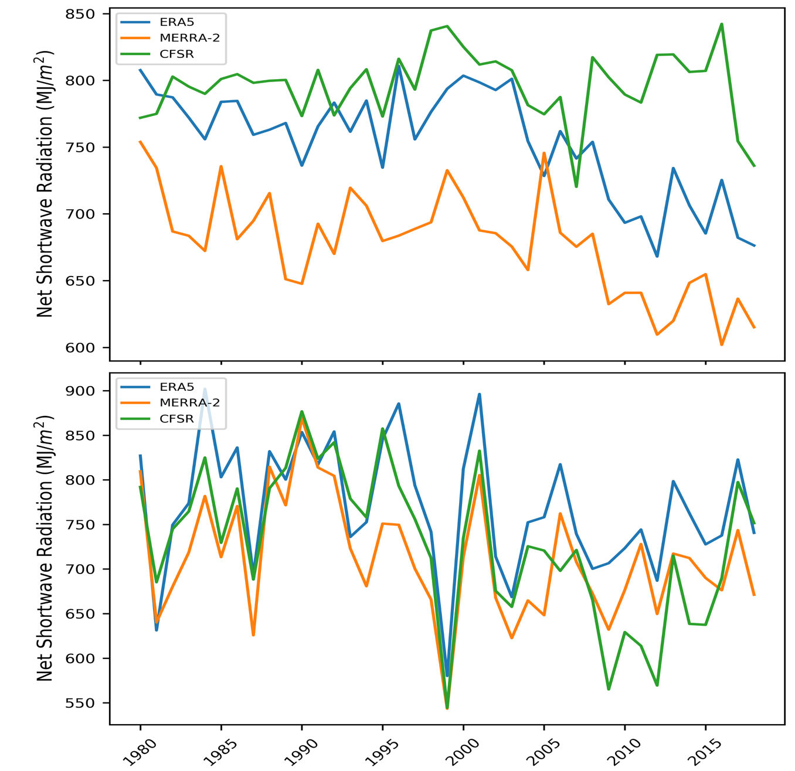
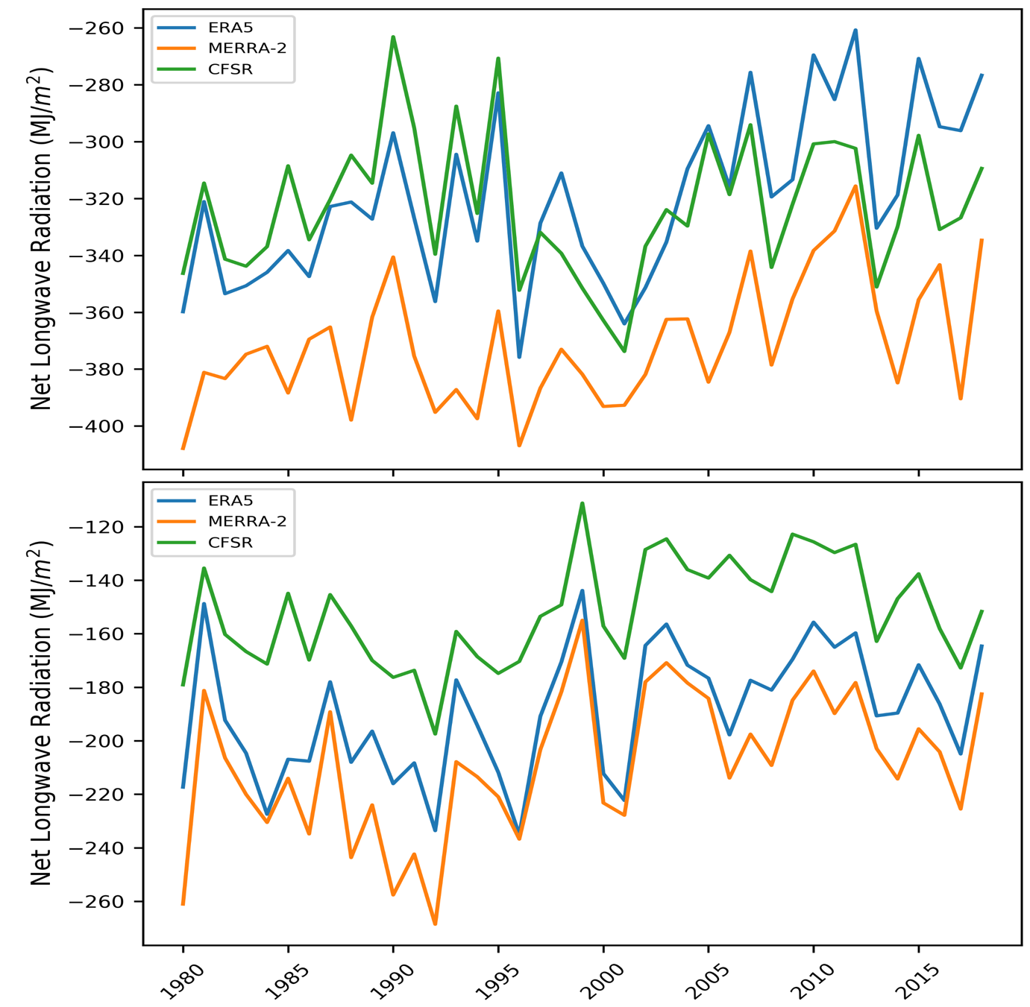
Even the basic radiative fluxes do not agree in these three reanalyses

Slide 13
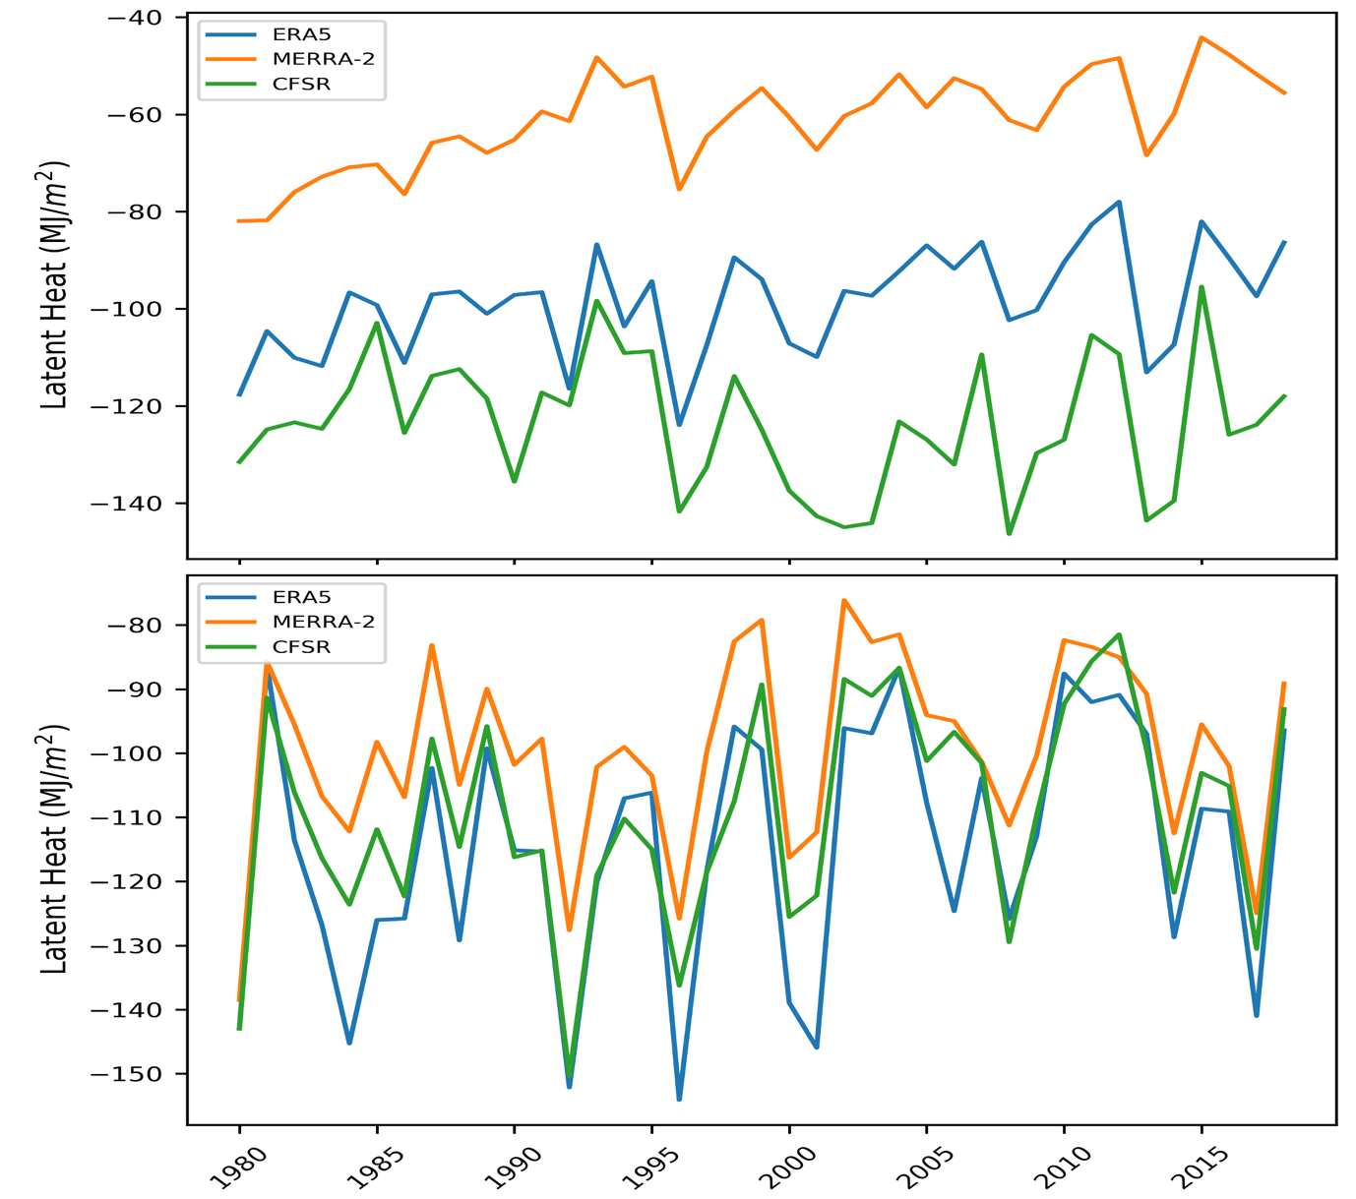
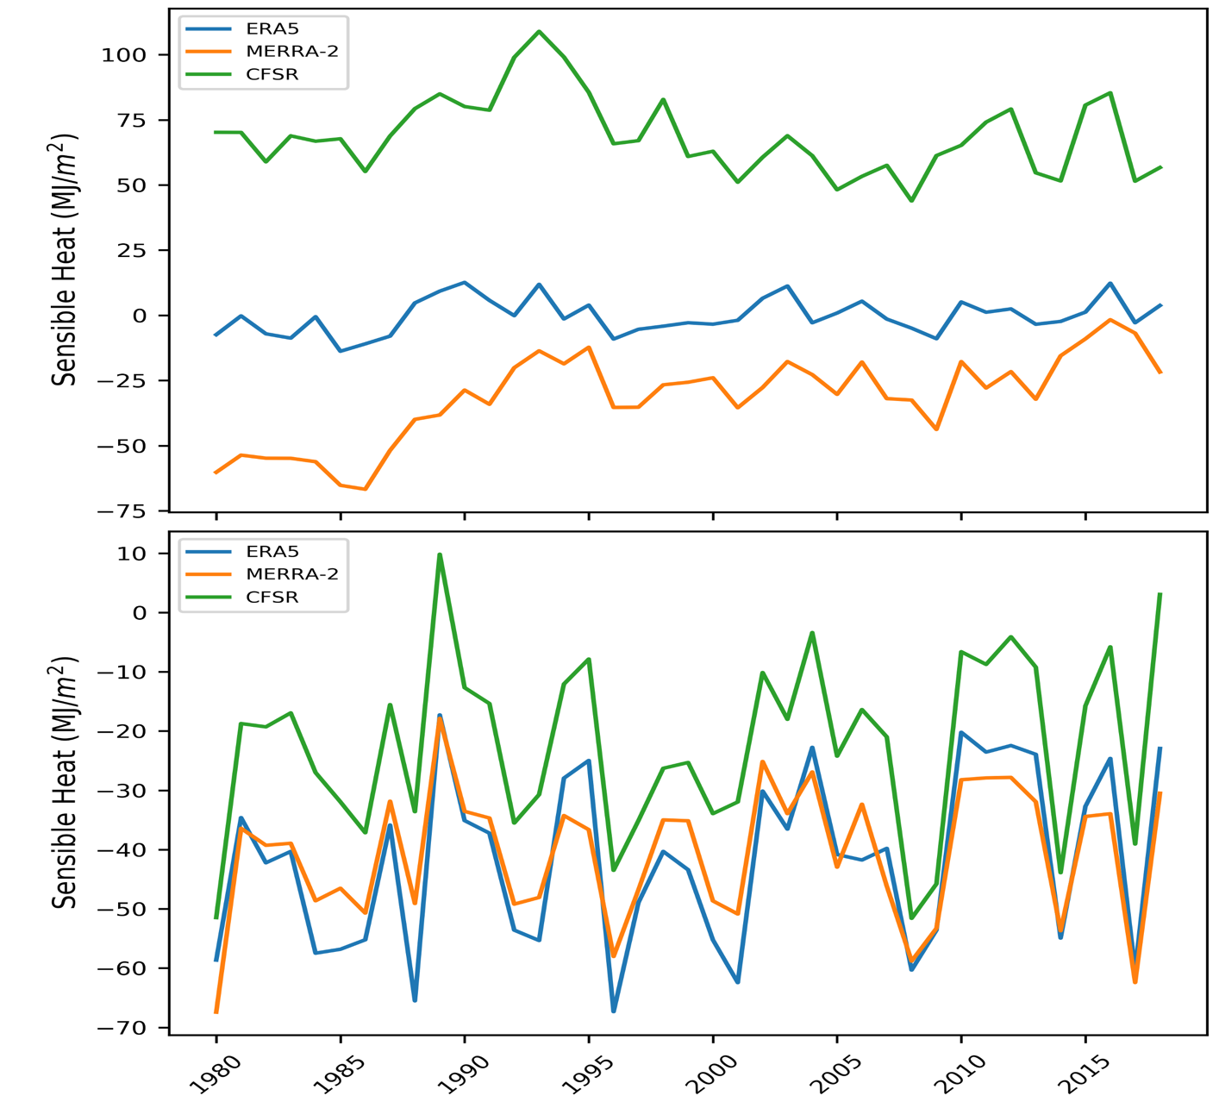
It is well documented that turbulent fluxes are not captured well in reanalyses and we see that here

Slide 14
Answered to the objectives
What are the spatial patterns in ocean heat gain over time (1979-2018)?
They are largely variable over time and have different patterns over ice and over open water
How different is the ocean heat gain between different reanalyses?
They are different but more so over sea ice surfaces
Does separating ocean heat gain over sea ice and open water change the trends?
Yes!
Is there a trend in ocean heat gain that fits with the observed decrease in sea ice extent?
Only in the values calculated for the whole Arctic Ocean region

Slide 15
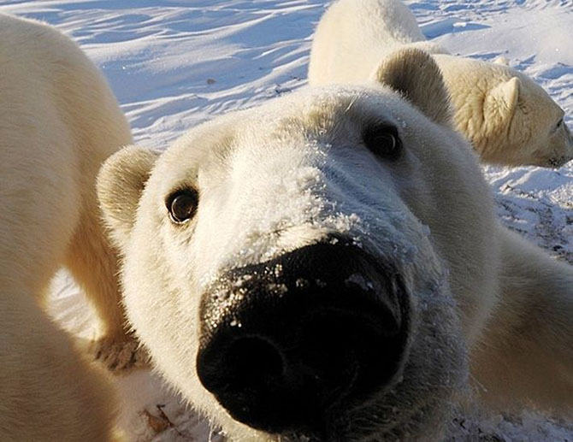
Thank you!
Notes:
Thank you for your time! Now I will take questions!

